Slide 1


Slide 2
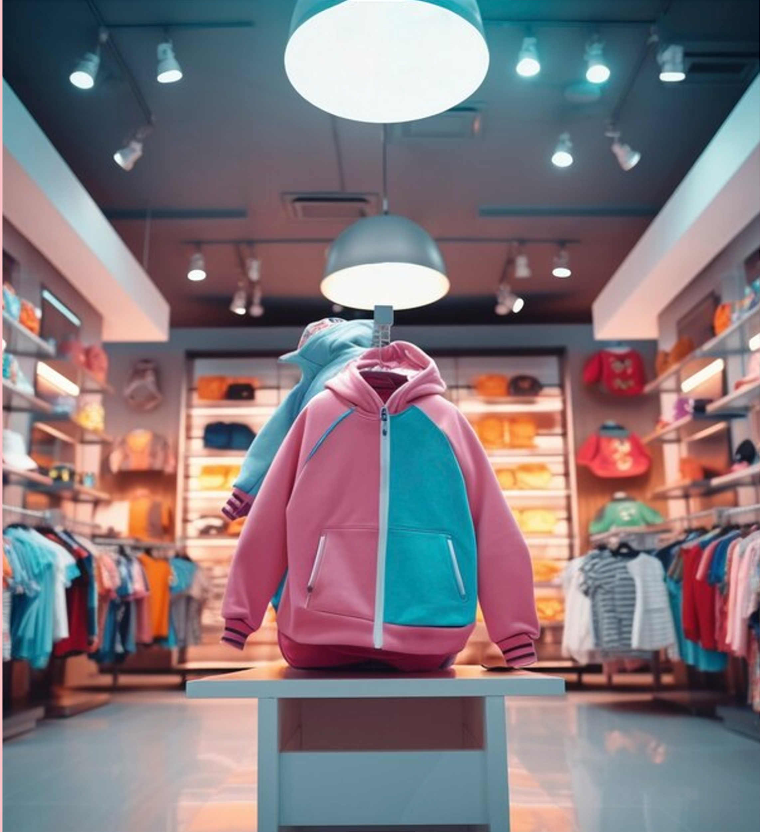

Swipe, Try, Buy
The world's first AI-powered fashion e-commerce aggregator marketplace, FITcheck empowers shoppers to discover, explore, and purchase the latest trends with ease.
Social SWIPE Shopping
Engage by swiping fashion styles suggested based on user history, like a tinder dating app.
TRY-ON Using AI Image Generation
Virtually try on outfits using AI image generation ttechnology, like a virtual closet.
BUYING for Price Check
Find the best price across multiple retailers, like a Skyscanner for clothes.

Slide 3





Imagine…
TINDER
FACE APP
SKYSCANNER
FITCHECK

Slide 4

AAA Three-Pillar Approach
FITCHECK's unique value proposition is built upon a three-pillar approach, seamlessly integrating cutting-edge technology, social engagement, and unbeatable deals to deliver an unparalleled shopping experience.
01
02
03
ALGORITHM Swiping
AI Image Generation
AGGREGATOR Marketplace
Our advanced algorithms analyze your browsing history, social media activity, and personal preferences to curate a personalized selection of fashion items tailored specifically to your unique style and needs.
Our state-of-the-art AI technology allows you to virtually try on any item, ensuring a perfect fit every time. Simply upload a photo or use our virtual avatar, and see how the clothes will look on you before you make a purchase.
Our advanced AI technology allows you to virtually try on items from various marketplaces, comparing prices from Amazon, Harrods, Farfetch, and more—all in one place.

Slide 5

Additional Features
Virtual Closet
(To save your FIT)
Pro Version Image Download (No Screenshot)
View prices, sizes, and shipping times from retail options
Subscription for additional features

Slide 6
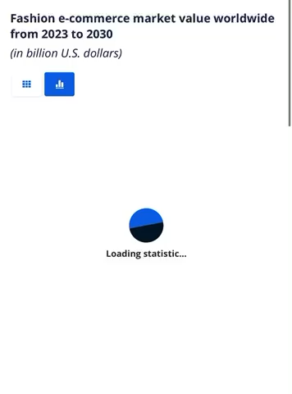
$1.627 Trillion
Global Market by 2030
Goal is to be multi-geographical, multi-cultural
Address excess purchasing product & logistic waste
Tackle advent of AI pricing with aggregator marketplace
Option to export AI image for consumer purchasers
Complete online retail experience

Slide 7


TARGETS
Phase 1
Concept R&D 1 Month (Complete)
Phase 2
Phase 3
Front End
UX Flow, Wire Frame & Design
Back End
LLM Link Stack & Server Research (2 weeks)
Front & Back End Development
GTM & Revenue Development
Landing Site (4 weeks)
Phase 4
Phase 5
QA Testing (1 week)
GTM Execution
IOS & Android Launch Requirements
Beta Launch
(2 months)

Slide 8
EXAMPLES TO REVIEW
ALGO SWIPE SHOPPING:
STYL APP, TINDER, RAYA, BUMBLE, INSTAGRAM
AI TRY-ON IMAGE GENERATION:
FACE APP, DAL-E, TRINITY AI, LUMA AI
AGGREGATOR PRICE MARKETPLACE:
SKYSCANNER, AMAZON, GOOGLE PRODUCT, FARFETCH, LYST

Slide 9





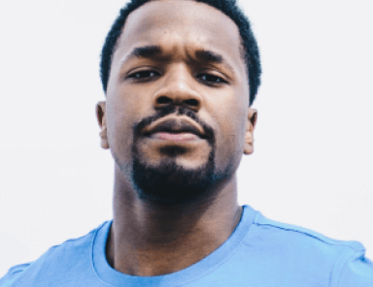
TEAM
Manish Batra
Sakshi Parkar
Chalukya Mohanraj
Product Manager
UX / UI Deaigner
Front Back Developer
Nida Naas
David Grim
Krizelle San Juan
QA Engineer
AI LLM Specialist
Team HR Manager:

Slide 10
Expectations
DAILY communication, PM + Lead,
Video meetings min X 2 WEEK
SF, NY, London, Dubai, India Team : Flexible
Waking hours in respective time zones
LAUNCH BETA 80 DAYS

Slide 11


Next Project

Slide 12






Who are we?

Slide 13
QUESTIONS?
WELCOME

